Slide 1
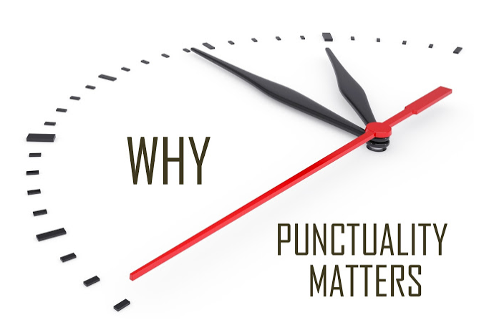
Airlines and Airports Punctuality Performance Analysis
By
Parag Siddamsettiwar
Abhishek Upadhayay

Slide 2
Why is this important?
In today’s busy world, time is a very precious commodity.
Flights are the most convenient and fastest way to travel.
More and more people are taking flights and according to IATA around 8.2 billion people will be travelling by flights in 2037. [1]
Flight delays and cancellations are a major cost escalator for passengers and Airlines.

Slide 3
Why is this important?
In today’s busy world, time is a very precious commodity.
Flights are the most convenient and fastest way to travel.
More and more people are taking flights and according to IATA around 8.2 billion people will be travelling by flights in 2037. [1]
Flight delays and cancellations are a major cost escalator for passengers and Airlines.

Slide 4

In 2010, passengers lost as much as $16.7 billion due to schedule buffer, delayed flights, flight cancellations and missed connections. [2]
According to a research an average Briton wastes 16 days of their holiday time waiting for their flight to take off. [3]

Slide 5
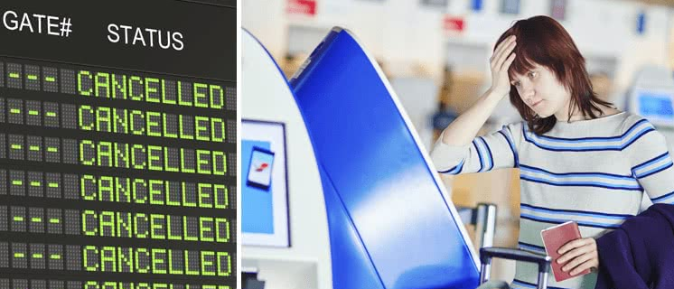

Remember the time when your flight was delayed or cancelled?
It will really help if we can visualize past flight data to get a better understanding of airlines and airports performance to make an informed choice before finalizing our travel plans.

Slide 6





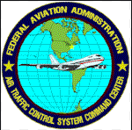
Existing analysis and visualizations
Most of the websites related to airlines and airports are travel booking websites, which only focus on seat availability and ticket prices.
There are handful of websites that provide an analysis on punctuality of airlines and airports.
Even the ones that are available are either on current data (real time or past few hours) and not an analysis on historical data for a proper analysis of trends or behavior.

Slide 7
Existing analysis and visualizations
Most of the websites related to airlines and airports are travel booking websites, which only focus on seat availability and ticket prices.
There are handful of websites that provide an analysis on punctuality of airlines and airports.
Even the ones that are available are either on current data (real time or past few hours) and not an analysis on historical data for a proper analysis of trends or behavior.

Slide 8
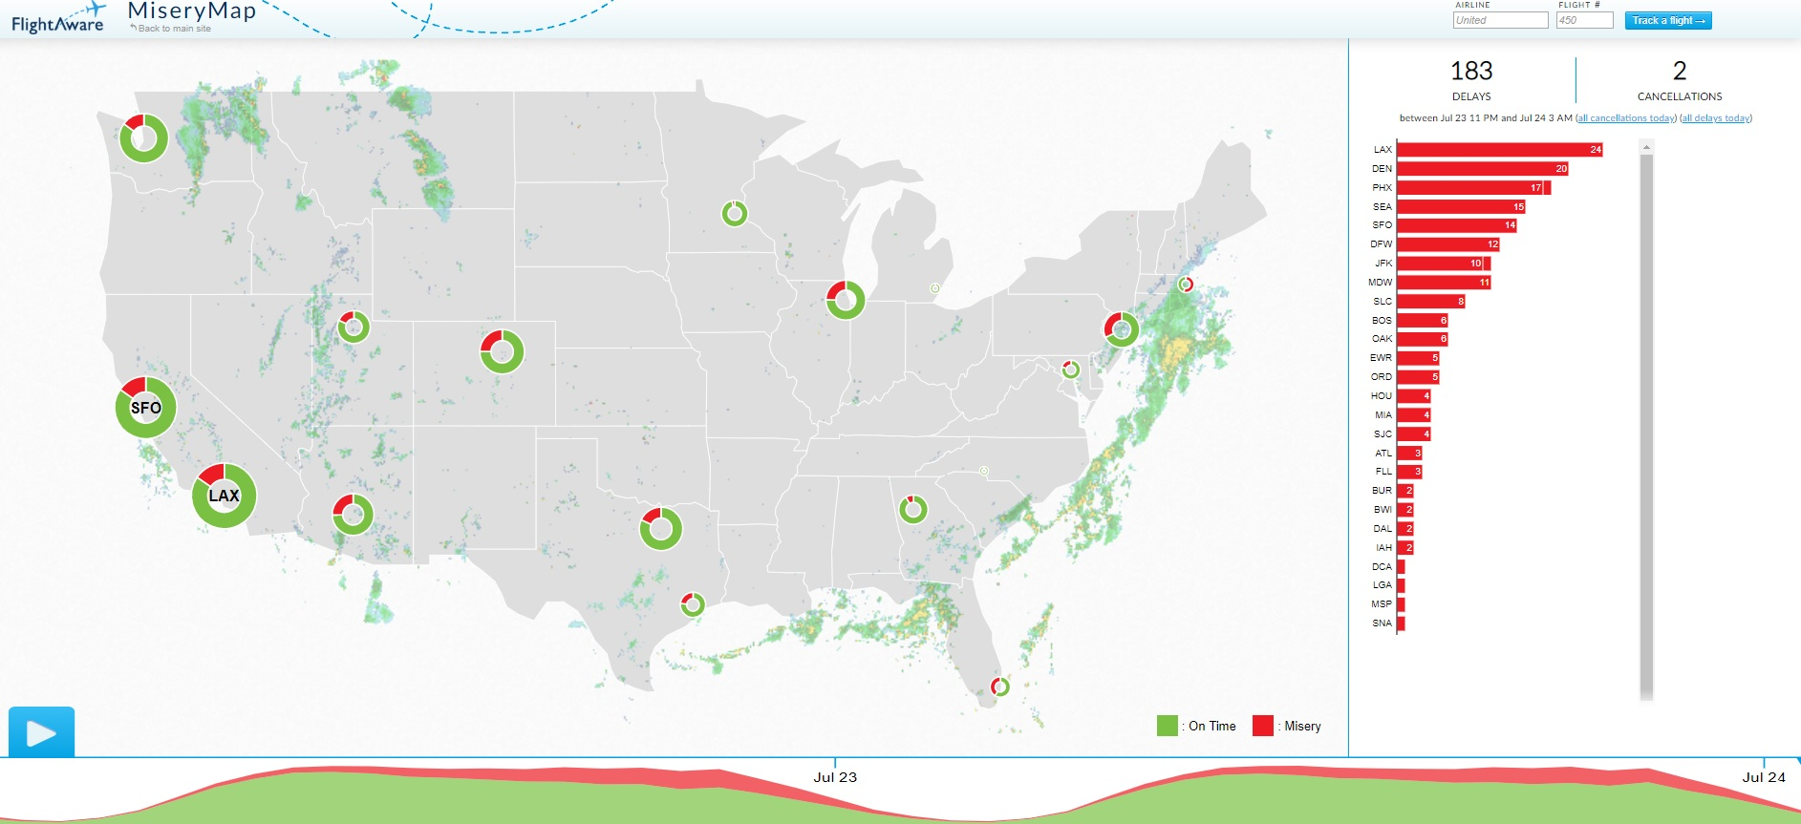
Flight aware flight delay visualization, MiseryMap 2019. [4] This visualization shows some big Airports only, no data available for Airlines and no option to choose other airports e.g. Indianapolis , Cincinnati etc. More importantly , this is based on current data (last few hours) and not an analysis on a historical dataset.

Slide 9
Flight aware flight delay visualization, MiseryMap 2019. [4] This visualization shows some big Airports only, no data available for Airlines and no option to choose other airports e.g. Indianapolis , Cincinnati etc. More importantly , this is based on current data (last few hours) and not an analysis on a historical dataset.

Slide 10
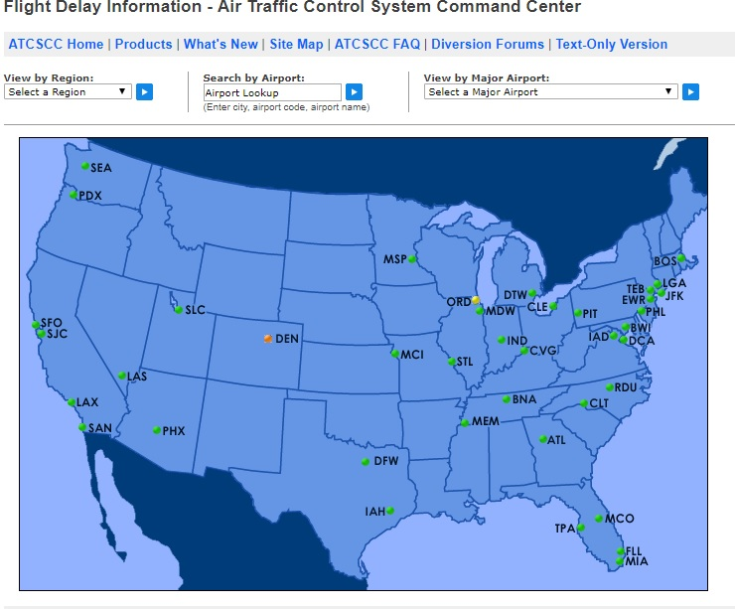
Flight Delay Information - Air Traffic Control System Command Center, 2019. [5] This visualization also shows airports and its also based on current data (last few hours) and not an analysis on a historical dataset. Its interactive and lets user select airport or flights and provides current situation for that.

Slide 11
Flight Delay Information - Air Traffic Control System Command Center, 2019. [5] This visualization also shows airports and its also based on current data (last few hours) and not an analysis on a historical dataset. Its interactive and lets user select airport or flights and provides current situation for that.

Slide 12
Are these visualizations enough?
There is not enough detail available that can help us in planning future travels from airports and airlines based on past trends and airlines behavior.
Even though a flight may show on time on these “current data” visualizations, its possible some of the airlines are regularly late when we analyze complete data.

Slide 13
Are these visualizations enough?
There is not enough detail available that can help us in planning future travels from airports and airlines based on past trends and airlines behavior.
Even though a flight may show on time on these “current data” visualizations, its possible some of the airlines are regularly late when we analyze complete data.

Slide 14
Objectives
Analyze past years data to compare various airlines and airports based on punctuality.
Create a series of visualizations in order to help a traveler find best choices of carrier and airports in terms of punctuality and certainty.
Visualizations should be easy to understand and pleasing to eyes.

Slide 15
Objectives
Analyze past years data to compare various airlines and airports based on punctuality.
Create a series of visualizations in order to help a traveler find best choices of carrier and airports in terms of punctuality and certainty.
Visualizations should be easy to understand and pleasing to eyes.

Slide 16
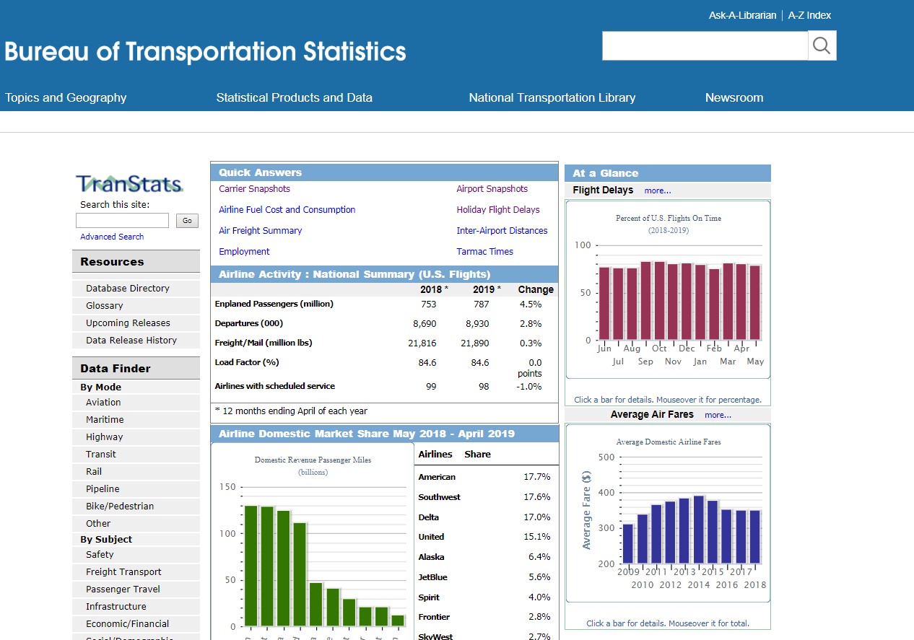
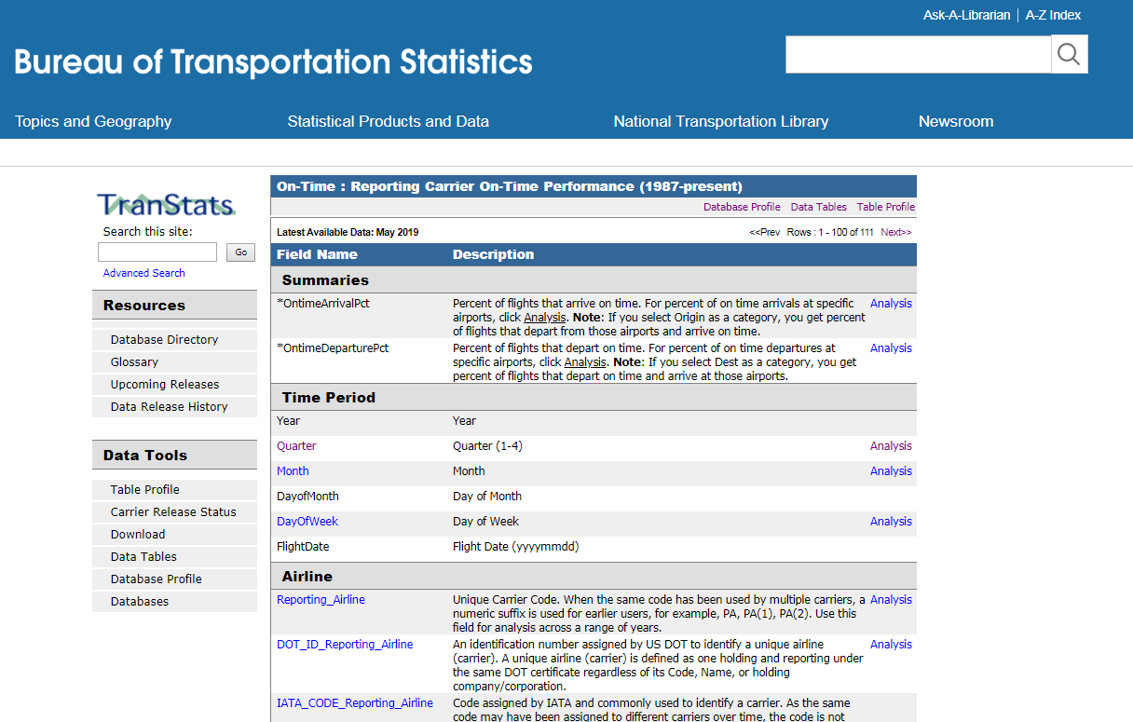
Dataset: Bureau of Transportation Statistics
This dataset is regularly updated and published. [6]
This is a large dataset with millions of records.

Slide 17
Dataset: Bureau of Transportation Statistics
This dataset is regularly updated and published. [6]
This is a large dataset with millions of records.

Slide 18
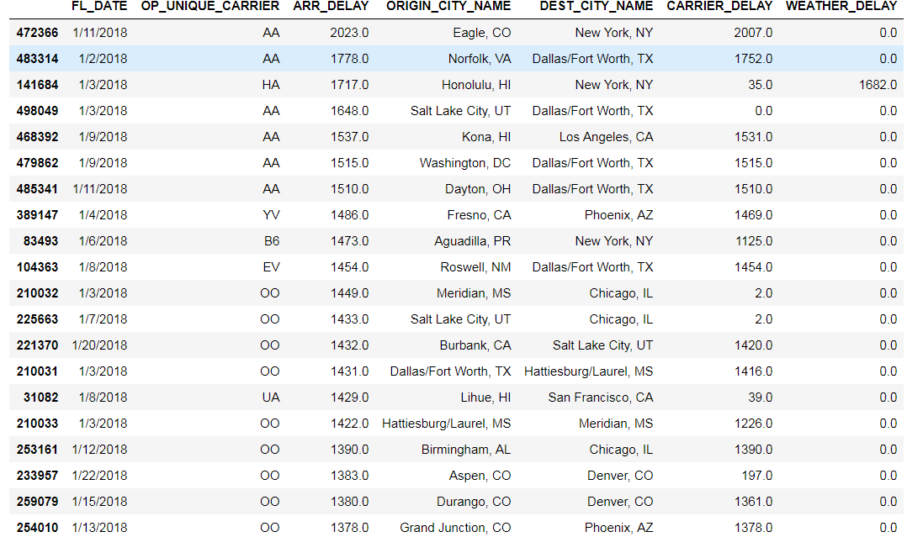
Top 20 delayed flights
The most delayed flight was of American Airlines, which was more than 2000 minutes delayed, almost 1.5 days.

Slide 19
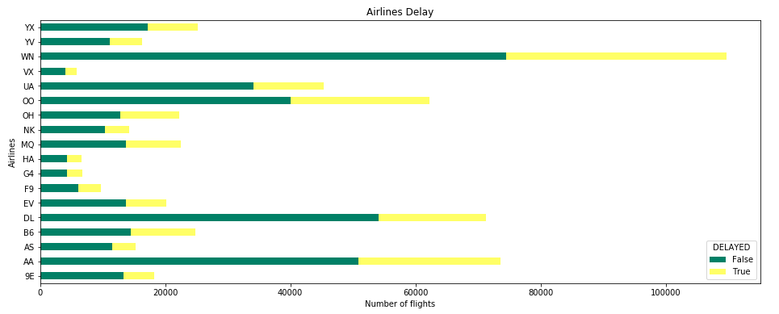
On time vs delayed ratio of flights per airline
Southwest Airlines(WN) had the highest number of delayed flights in a month of January. All airlines had arrival delay.

Slide 20
On time vs delayed ratio of flights per airline
Southwest Airlines(WN) had the highest number of delayed flights in a month of January. All airlines had arrival delay.

Slide 21
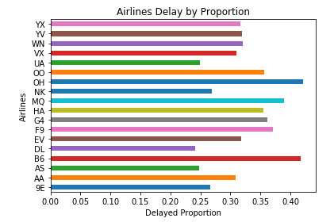
Airline carrier delays proportion
Clearly the ones that looked like had more delays are actually better when compared with proportions e.g. Southwest (WIN) and Delta(DL)

Slide 22
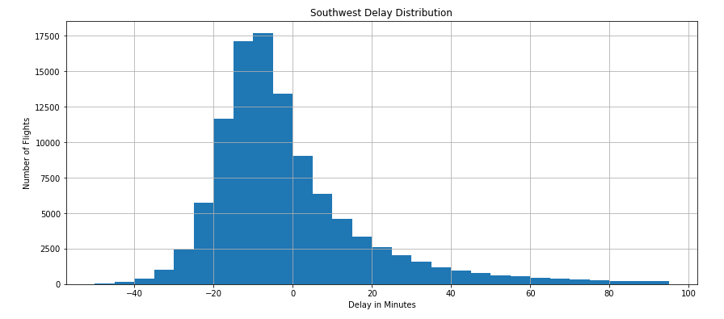
Southwest delay distribution
Looks like southwest mostly arrives before time even during January's stormy winters.
So, it’s a good airline to book your travel in January.

Slide 23
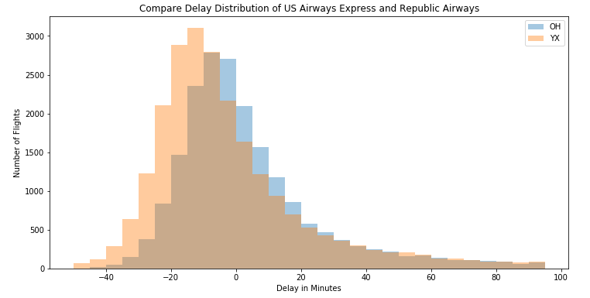
Comparing delay distribution of US Airways & Republic Airways
The distribution looks similar, but they are not the same as US Airways Express has more shift to the right because of more delays.

Slide 24
Comparing delay distribution of US Airways & Republic Airways
The distribution looks similar, but they are not the same as US Airways Express has more shift to the right because of more delays.

Slide 25
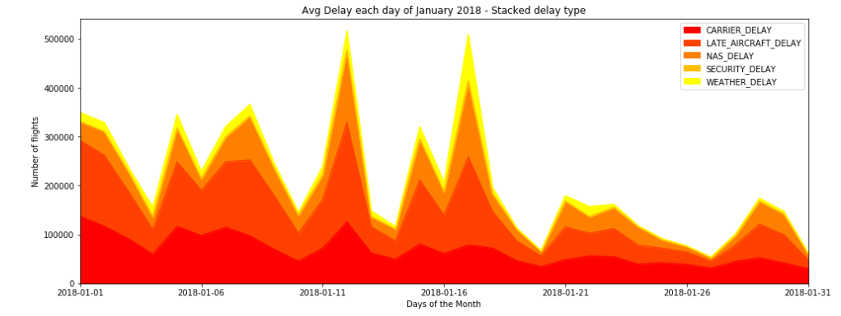
Flight delay reason stacked area chart
This is showing total number of flights delayed with delay reasons stacked on top of each other for the month of January.
autumn’ color map was a good option as it had an effect of heat map on the area with larger share shown with a darker color.

Slide 26
Flight delay reason stacked area chart
This is showing total number of flights delayed with delay reasons stacked on top of each other for the month of January.
autumn’ color map was a good option as it had an effect of heat map on the area with larger share shown with a darker color.

Slide 27
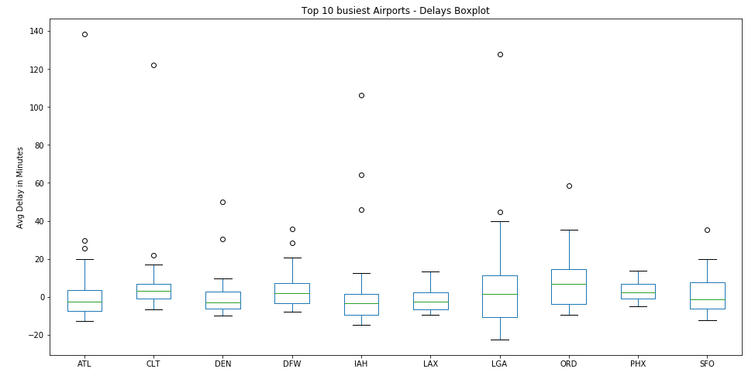
Top 10 Busiest airports and their delays
While other airports delays are evenly distributed around 0, we can see clear dispersion in data at LaGuardia NYC and Ohare' Chicago.
Based on 2018 data, we can say that try to avoid these two airports during January.

Slide 28
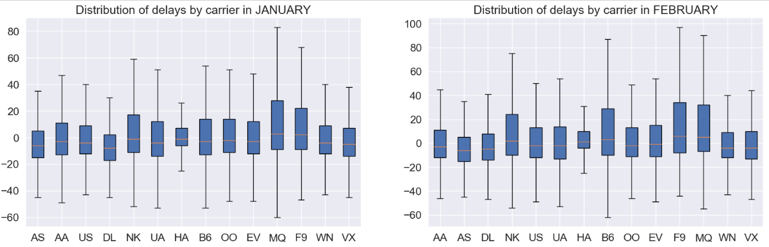
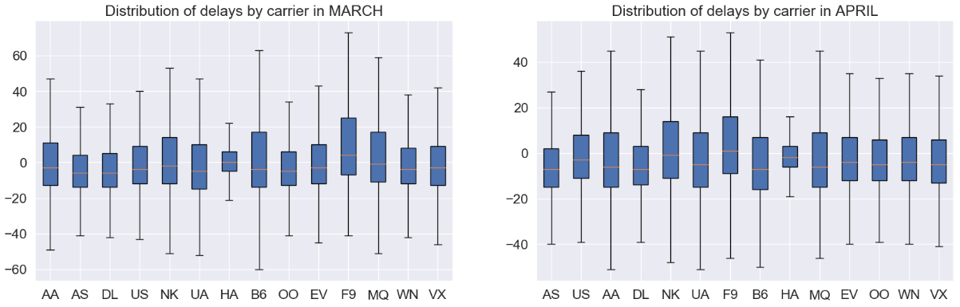
Distribution of delays by carrier
Subplots of airline carrier and delay by month for the whole year.

Slide 29
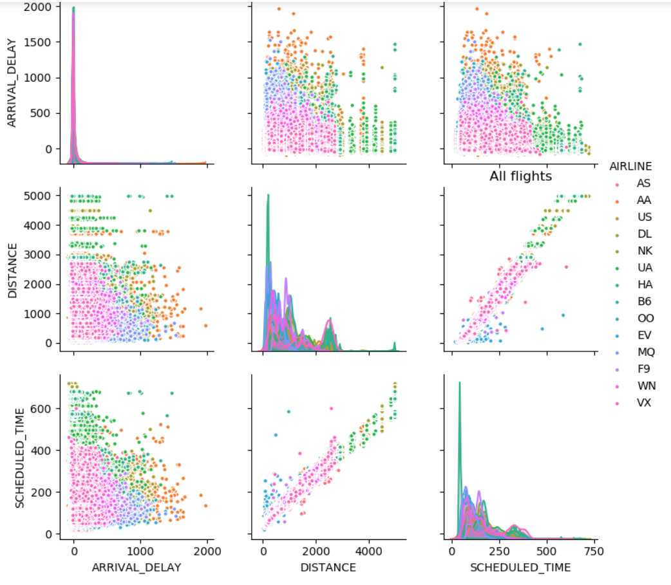
Comparing airline, arrival delay, distance and scheduled time using pair-plot
The Distance vs Arrival Delay graph is suggesting that as the distance increases, the number of flights with large delays decreases.
It may be due to the long-haul flights covering the delay on their way or airlines may simply cancel significantly delayed long haul flights.

Slide 30
Comparing airline, arrival delay, distance and scheduled time using pair-plot
The Distance vs Arrival Delay graph is suggesting that as the distance increases, the number of flights with large delays decreases.
It may be due to the long-haul flights covering the delay on their way or airlines may simply cancel significantly delayed long haul flights.

Slide 31
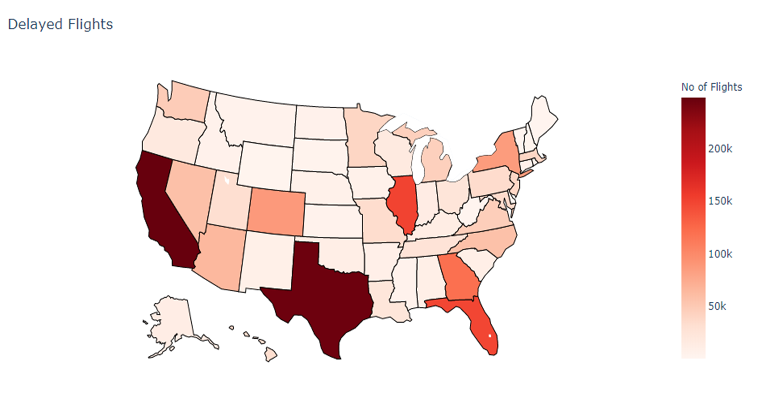
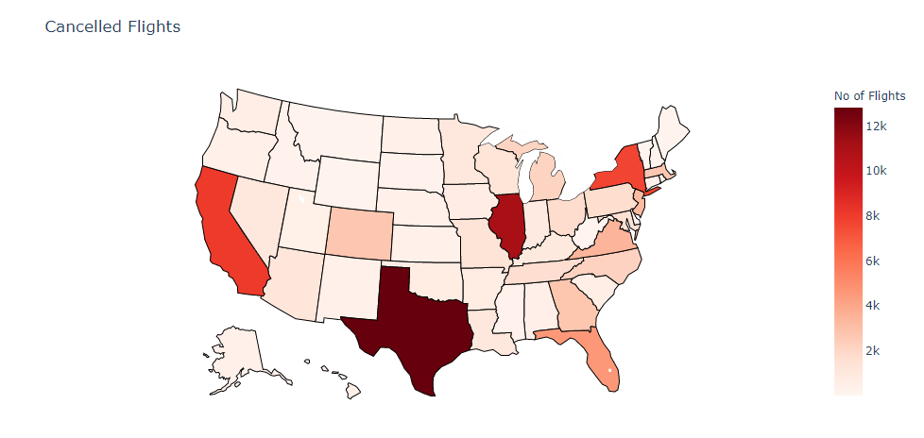
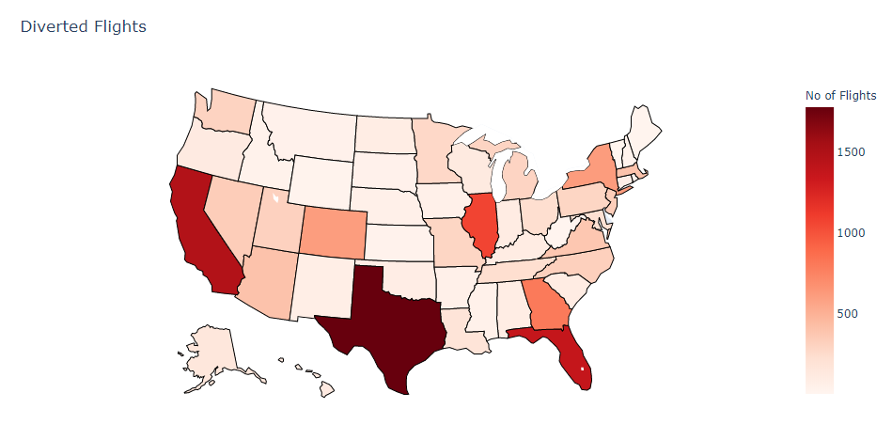
Choropleth maps
Even though we have some good information shown in these maps, its still misleading as it is based on absolute number of flights.
States like Texas, California and New York with large number of flights (even if they have better proportion) will be displayed in darker color in these maps.

Slide 32
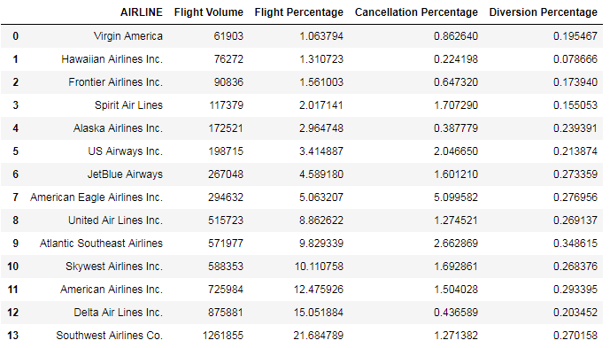
Calculating cancellation, diversion rate and flight percentage for each airline carrier
This is showing that southwest is a market leader with around 22% of all the total US domestic flights while it only had 1.3 % of flights cancelled (of all US domestic flights).

Slide 33
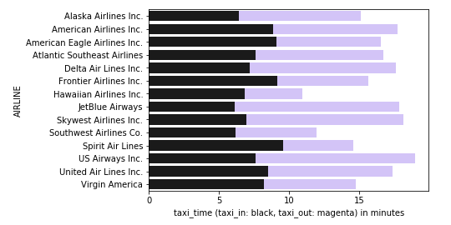
Taxi-in vs taxi-out in stacked bar chart for every airline
It is clearly visible that US airways has largest taxi-in and taxi-out time amongst all the airlines. Hawaiian Airline flights spends least time on taxi-in and taxi-out.

Slide 34
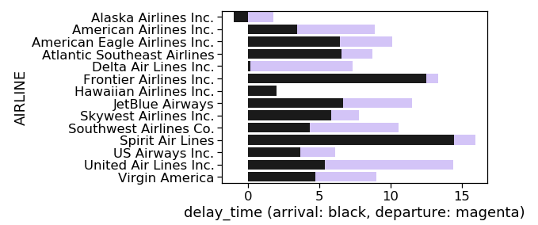
Arrival vs departure delay for every airline
We can clearly infer from this visualization that Delta airlines almost has no arrival delay time whereas Alaska airlines has negative arrival delay. That means Alaska airlines most of the times reached before time. Spirit airlines performs worst when it comes to these delays with the highest arrival delay.

Slide 35
Arrival vs departure delay for every airline
We can clearly infer from this visualization that Delta airlines almost has no arrival delay time whereas Alaska airlines has negative arrival delay. That means Alaska airlines most of the times reached before time. Spirit airlines performs worst when it comes to these delays with the highest arrival delay.

Slide 36
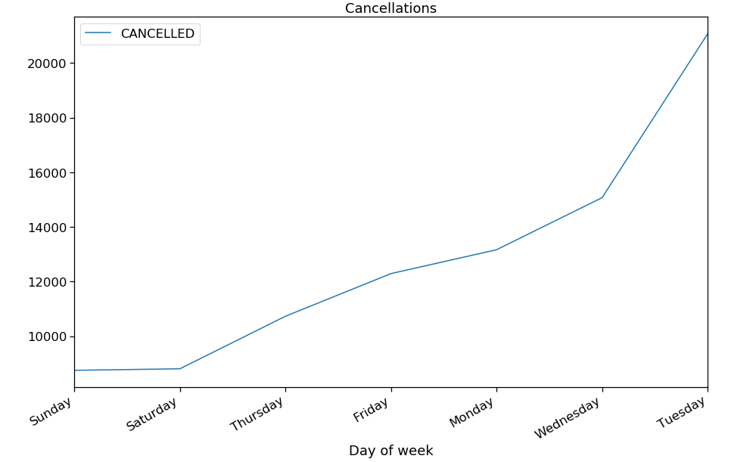
Week by cancellation
Cancellation is highest on Tuesdays and lowest on Sunday & Saturday.
This can be due to less number of passengers travelling on weekdays just after the weekend resulting and underutilization of flights and thus higher cancellations.

Slide 37
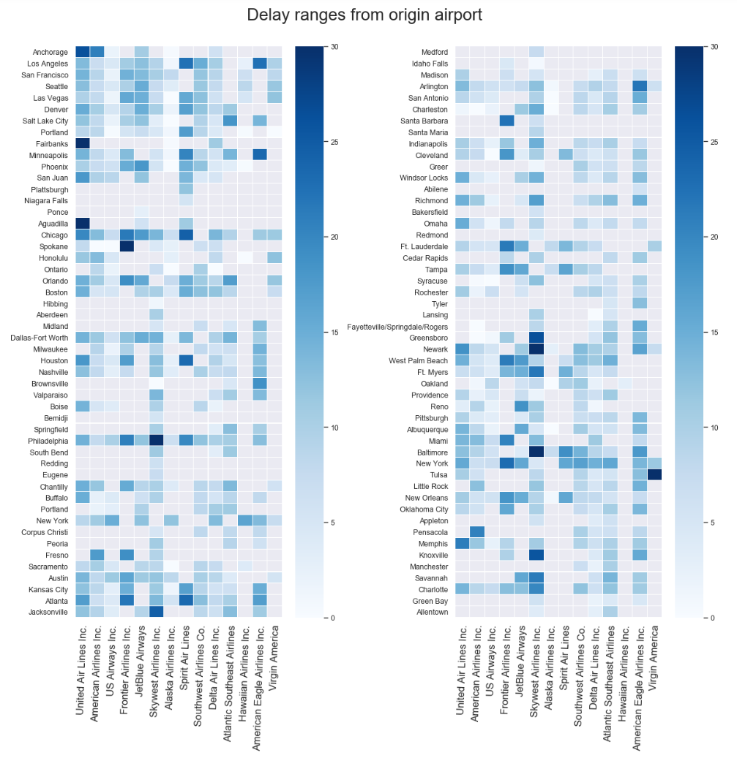
This heat map visualizes delays of all the airlines at each airport of our dataset.
The severity of the total delay is encoded in the darkness of shade shown in the grid.
E.g. Avoid Spirit airlines at Chicago and avoid SkyWest in Newark.

Slide 38
This heat map visualizes delays of all the airlines at each airport of our dataset.
The severity of the total delay is encoded in the darkness of shade shown in the grid.
E.g. Avoid Spirit airlines at Chicago and avoid SkyWest in Newark.

Slide 39
Insights and conclusions
The visualizations presented clearly showed airports that one can avoid for travel during a particular time period. E.g. Avoid travelling to Chicago and LaGuardia in January (Top 10 Busiest airports and their delays).
Southwest is a market leader with around 22% of all the total US domestic flights (Calculating cancellation, diversion rate and flight percentage for each airline carrier) while it only had 1.3 % of flights cancelled. Southwest also fared well in total number of delayed flights and severity of delays. So basically, use Southwest!
The main reason for delay in January is not ‘weather delay’, as popular belief suggests but other delays like ‘Carrier Delay’ and ‘Late Aircraft Delay’. (Flight delay reason stacked area chart)
Most number of flights are cancelled on Tuesday (probably due to empty flights), so avoid Tuesday if you want to avoid the hassle.
Finally, the visualization ‘Delay Ranges from Origin Airport’ provides good heat map for a traveler to assess his/her choices to make an informed decision about travel. E.g. We will avoid Virgin airlines at Tulsa and SkyWest airlines for Newark and Baltimore due to their large delays at these airports last year.

Slide 40
Insights and conclusions
The visualizations presented clearly showed airports that one can avoid for travel during a particular time period. E.g. Avoid travelling to Chicago and LaGuardia in January (Top 10 Busiest airports and their delays).
Southwest is a market leader with around 22% of all the total US domestic flights (Calculating cancellation, diversion rate and flight percentage for each airline carrier) while it only had 1.3 % of flights cancelled. Southwest also fared well in total number of delayed flights and severity of delays. So basically, use Southwest!
The main reason for delay in January is not ‘weather delay’, as popular belief suggests but other delays like ‘Carrier Delay’ and ‘Late Aircraft Delay’. (Flight delay reason stacked area chart)
Most number of flights are cancelled on Tuesday (probably due to empty flights), so avoid Tuesday if you want to avoid the hassle.
Finally, the visualization ‘Delay Ranges from Origin Airport’ provides good heat map for a traveler to assess his/her choices to make an informed decision about travel. E.g. We will avoid Virgin airlines at Tulsa and SkyWest airlines for Newark and Baltimore due to their large delays at these airports last year.

Slide 41
Future work
This project is just a start in our data science journey. A lot can be done on top of what we have achieved in this project.
These visualizations were a deep dive on a limited data to prove our concept, we can load historical data to come up with a trend in a future work.
We want to make our visualizations more interactive; we want to create visualizations that will allow users to select airports, airlines, states and time periods to analyze.
We can create a visualization where if you enter boarding and destination airports, it will provide best airlines based on punctuality analysis. We have to create algorithms in python to achieve this.

Slide 42
Future work
This project is just a start in our data science journey. A lot can be done on top of what we have achieved in this project.
These visualizations were a deep dive on a limited data to prove our concept, we can load historical data to come up with a trend in a future work.
We want to make our visualizations more interactive; we want to create visualizations that will allow users to select airports, airlines, states and time periods to analyze.
We can create a visualization where if you enter boarding and destination airports, it will provide best airlines based on punctuality analysis. We have to create algorithms in python to achieve this.

Slide 43
References
IATA Forecast Predicts 8.2 billion Air Travelers in 2037 https://www.iata.org/pressroom/pr/Pages/2018-10-24-02.aspx [1]
Annual U.S. Impact of Flight Delays (NEXTOR report) http://airlines.org/data/annual-u-s-impact-of-flight-delays-nextor-report/ [2]
Holidaymakers 'waste 16 days waiting in airports over lifetime https://www.telegraph.co.uk/travel/travelnews/7546209/Holidaymakers-waste-16-days-waiting-in-airports-over-lifetime.html [3]
FlightAware MiseryMap https://flightaware.com/miserymap/ [4]
Flight Delay Information - Air Traffic Control System Command Center https://www.fly.faa.gov/flyfaa/usmap.jsp [5]
Transtats https://www.transtats.bts.gov/Tables.asp?DB_ID=120&DB_Name=Airline%20On-Time%20Performance%20Data&DB_Short_Name=On-Time [6]

